Slide 1
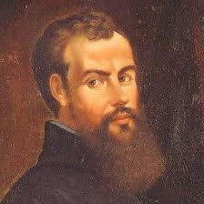
Andreas vesalius
His work and drawings

Slide 2
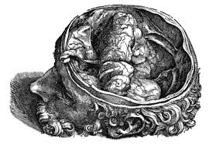
A head

Slide 3
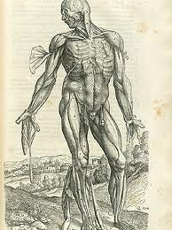
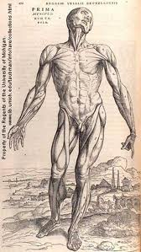
Some bodies

Slide 4
About him
Andreas Vesalius was born in Brussels in 1514 and lived till 1564. when he was 24 he became a profesor of anatomy in Padua in Italy. He sometimes keplt human corpses in his room. He helped correct many beliefs since the ancient times. He made important illustrations about the human body.

